Slide 1
Debugging

Slide 2
Debugging
BrokenPalindrome
run the program:
The circle created on Exception in thread "main" java.util.IllegalFormatConversionException: c != java.lang.String
at java.util.Formatter$FormatSpecifier.failConversion(Formatter.java:4302)
at java.util.Formatter$FormatSpecifier.printCharacter(Formatter.java:2869)
at java.util.Formatter$FormatSpecifier.print(Formatter.java:2757)
at java.util.Formatter.format(Formatter.java:2520)
at java.io.PrintStream.format(PrintStream.java:970)
at examples.core.Circle.printCircle(Circle.java:41)
at examples.core.TestCircle.main(TestCircle.java:9)
Always start you debugging by selecting the first line (from the top) that contains your code

Slide 3
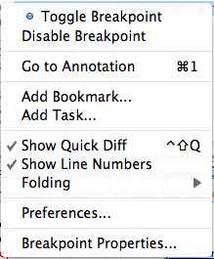
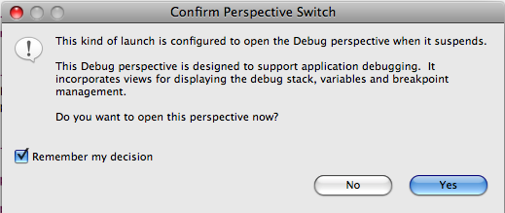
Debugging
Right-click on line number 41
Select Toggle Breakpoint
Then Select Run > "Debug As” > "Java Application"
Notes:
Talk a bit about Java Perspectives

Slide 4
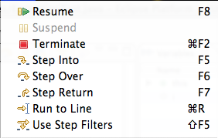

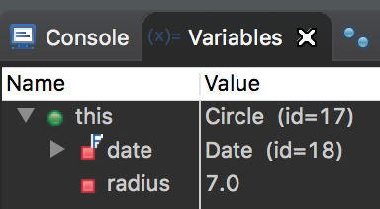
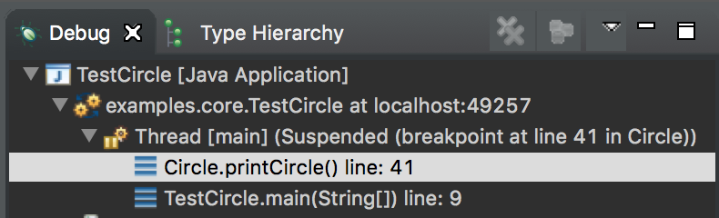
Debugging
F5 - step into the method
F6 - step over the method
F7 – step back out
You can examine variables in the “Variables" tab
You can see the execution stack in the “Call stack" tab

